Slide 1
Continuous Integration: Do It Continuously
A Learning Experience
Having Fun with LEGO

Slide 2
Integration the Waterfall Way
Notes:
Next up on our agenda is Integration.
Our definition:
In engineering, system integration is the bringing together of the component subsystems into one system and ensuring that the subsystems function together as a system. In information technology, systems integration is the process of linking together different computing systems and software applications physically or functionally.

Slide 3
In engineering, system integration is the bringing together of the component subsystems into one system and ensuring that the subsystems function together as a system. In information technology, systems integration is the process of linking together different computing systems and software applications physically or functionally.

Slide 4
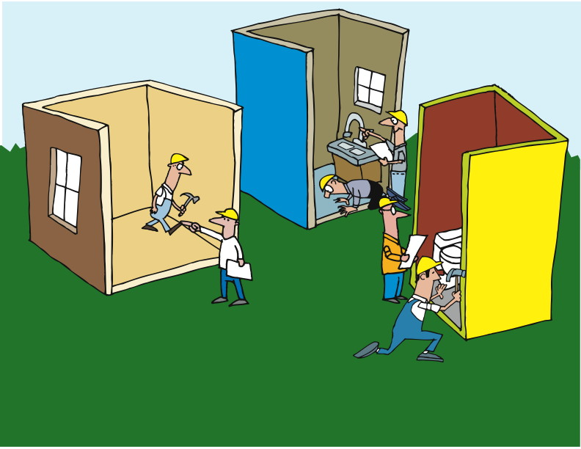
Notes:
Each project or subsystem working in isolation from the others.
Some communication, but not enough.
Limited to integration specific discussions.
Tested loosely until the parts are integrated as a whole.
---------------------------------------------------------------------------------------------------
In a Waterfall world, each project or subsystem team works mostly in isolation from the others. There will likely be some communication between the teams, but generally speaking each team specializes in the part they’re building, and only talks to the others when they need to discuss an interface.
Testing of the interfaces is likely to be done loosely, as it is believed that the most effective testing will be done when the parts are integrated into the whole.

Slide 5
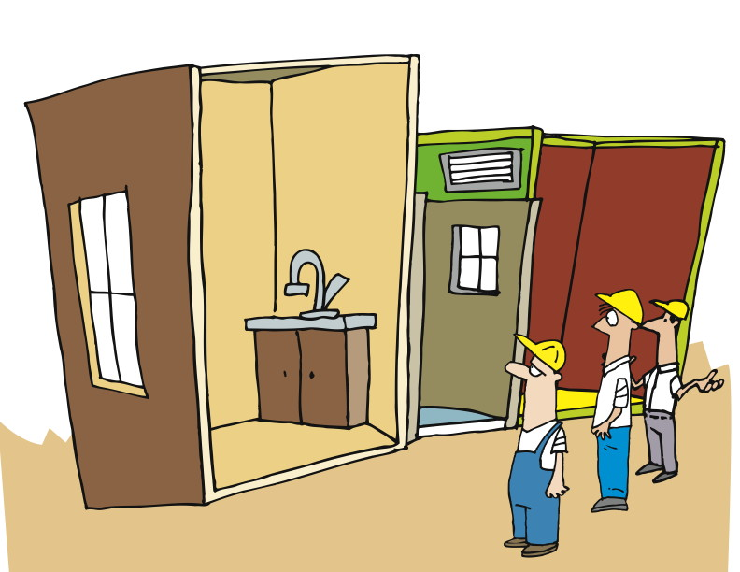
Notes:
Of course, there are problems with this. They can be as simple as getting the data type wrong for an argument, and as complex as transformations that are applied to data within one subsystem that make it incompatible with another.
The biggest problem, of course, is that the teams do ALL the work before ever trying to bring things together.

Slide 6
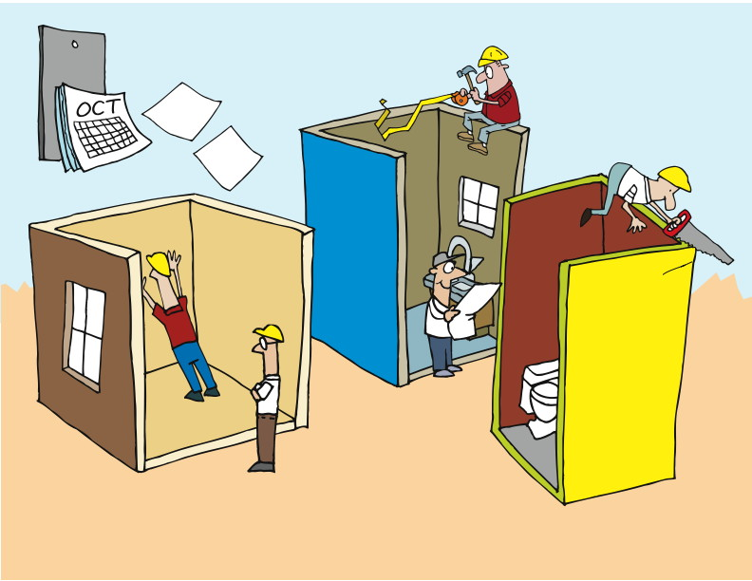
Notes:
Which means that we have the same problem we had when we talked about pairing and catching defects early: rework.
When you’ve built the whole thing, and then have to go back and figure out where the problems are and who should fix which and how, well, it just gets complicated and costly and time-consuming.

Slide 7
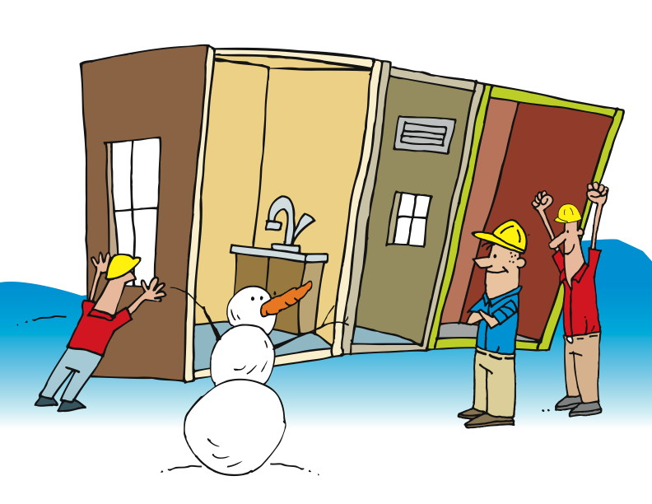
Eventually…
Notes:
Ultimately, the team may meet with success. But along the way, the pain is shared by everyone.

Slide 8
The Agile Way: Continuous Integration
Notes:
An approach that has been adopted successfully on Agile teams, and is making its way onto teams of all kinds, is Continuous Integration. This is a term that was originally described in a blog post by [CLICK] Martin Fowler in September of 2000.
“Continuous Integration is a software development practice where members of a team integrate their work frequently, usually each person integrates at least daily - leading to multiple integrations per day. Each integration is verified by an automated build (including test) to detect integration errors as quickly as possible. Many teams find that this approach leads to significantly reduced integration problems and allows a team to develop cohesive software more rapidly.”
http://www.martinfowler.com/articles/continuousIntegration.html

Slide 9

“Continuous Integration is a software development practice where members of a team integrate their work frequently, usually each person integrates at least daily - leading to multiple integrations per day. Each integration is verified by an automated build (including test) to detect integration errors as quickly as possible. Many teams find that this approach leads to significantly reduced integration problems and allows a team to develop cohesive software more rapidly.”
http://www.martinfowler.com/articles/continuousIntegration.html
Notes:
Read the slide.

Slide 10
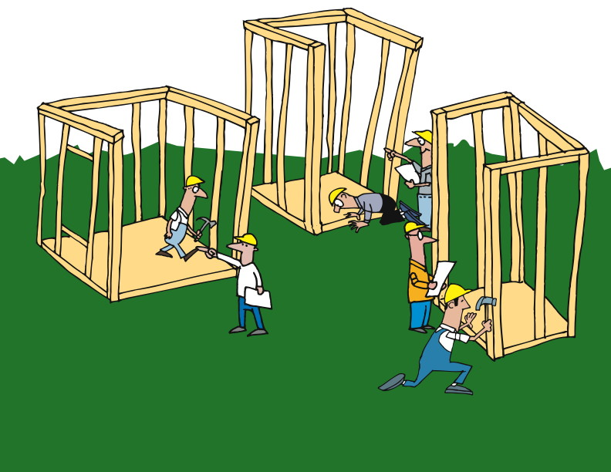
Independent Action
Notes:
We’ve got separate teams working on separate parts
We may be able to rotate personnel, but maybe not
------------------------------------------------------------------------------------------------------------------
Let’s consider the same scenario we discussed a minute ago.
We have separate teams, each of which is working on a piece – a class, a subsystem, a system, whatever it is – that is intended to connect and work with the other parts.
There’s really no functional alternative to having focused teams. While it’s possible to rotate personnel between teams, it’s likely that the disruption would be too great to justify the practice.
So we’ve got separate teams working on separate parts.

Slide 11
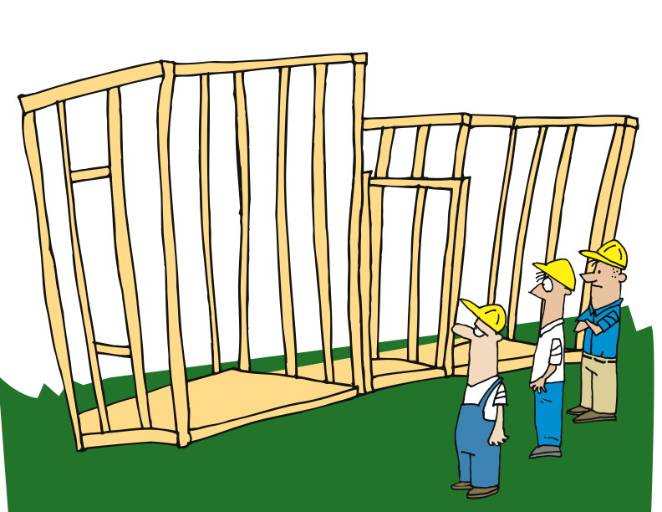
Check and Fail Early
Notes:
Continuous Integration incorporates short cycles to identify issues early
Failing fast, fail early does not mean we want to fail
It means find the failures as early as possible to reduce cost
A joke in chicago on election days is “Vote early, vote often”. Integrate early, Integrate often.
The big difference with Continuous Integration is that we incorporate short cycles so that we can identify issues as early as possible.
In the Agile world, we talk about failing fast or failing early. This is sometimes misunderstood to mean that we are hoping to fail or planning to fail. That’s not so. What we are doing is acknowledging that failures will occur, and hoping to find them as soon as possible to minimize their total impact.
One of the most important tools in this approach is continuous integration.
At regular – and short – intervals, we bring everything together to see if what we’ve done so far all works well together.

Slide 12
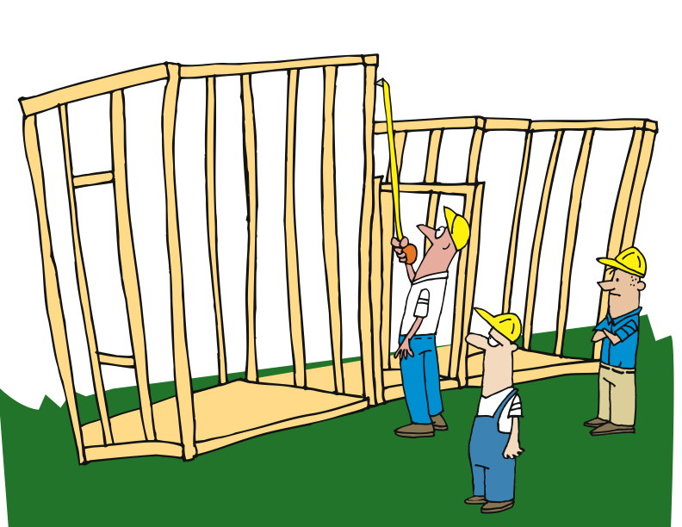
Check
Notes:
Check and test regularly
CI processes may run every time someone checks in code
Full suite of tests run against the code
Remember TDD
Builds take too long. There are ways to address this.
Rather than waiting until we’re all done – or at least, we THINK we’re all done – we do our checking and testing and integrating on a regular basis.
In fact, depending on your circumstances, it’s pretty common for development teams to set up the continuous integration process to run every time someone checks in code. That means that a full suite of tests is run against the code every time someone makes a change.
Don’t forget about our earlier discussion of Test-Driven Development. We embrace the practice of writing tests for all of our development, so that test base grows every time code is checked in too.
Of course, at some point, it starts to take too long to run ALL the tests every time someone checks in code. There are solutions to this, which are beyond the scope of this module. Suffice it to say that others have run into this problem, and have taken steps to address them. In fact, Cruise, the continuous integration server from ThoughtWorks Studios, was specifically designed to address this from day one.

Slide 13
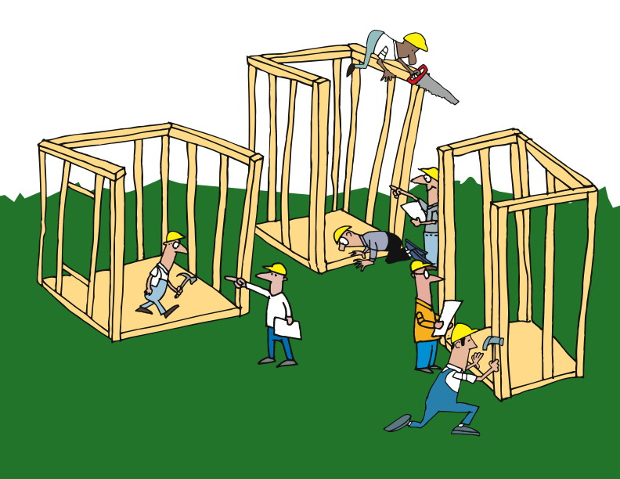
Adapt / Do
Notes:
Plan, Do, Check, Act continuously
------------------------------------------------------------------------------------------------
By embracing continuous integration – compiling, linking, loading, testing, and deploying – on an ongoing basis, we have a much better chance of failing early and finding and fixing problems when the cost is at its lowest.
As we follow the PDCA (remember that that stands for Plan, Do, Check, Act) cycle, we are continuously finding and fixing problems, and responding to situations close to when they occur.

Slide 14
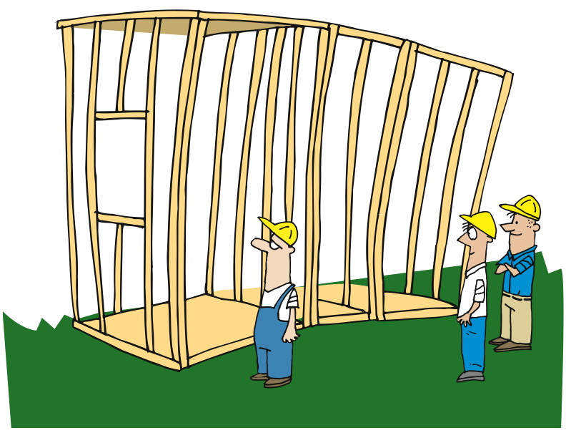
Notes:
That cycle of rapid and timely feedback allows us to make changes and corrections early.

Slide 15
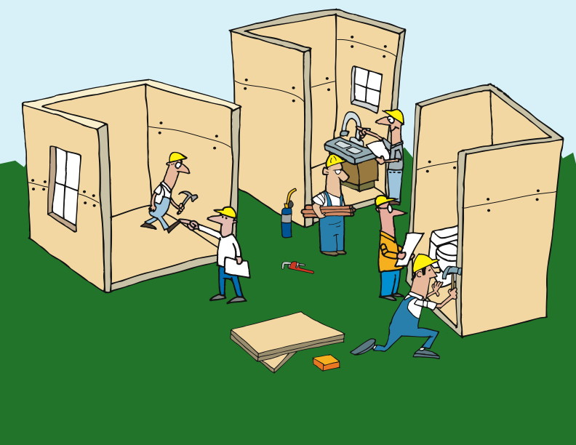
Notes:
And because we do this on an ongoing basis…

Slide 16
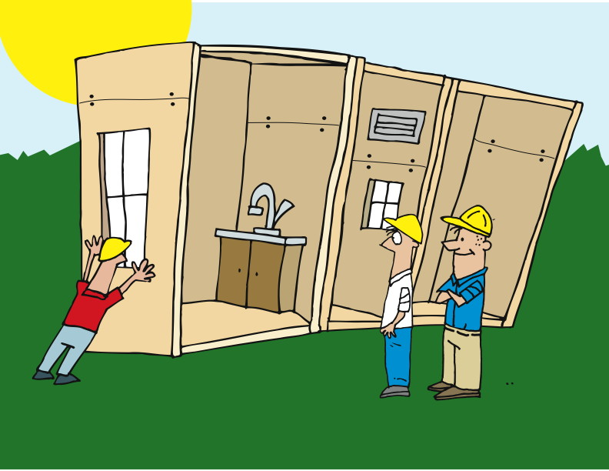
Notes:
Working software at the end of each iteration.
We are checking for and finding problems much earlier, so that we are fulfilling one of the principles of Agile: working software at the end of each iteration. Rather than waiting months or years to be able to see and use the software under development, we are using continuous integration to make sure that all of our parts work, and that they work together.

Slide 17
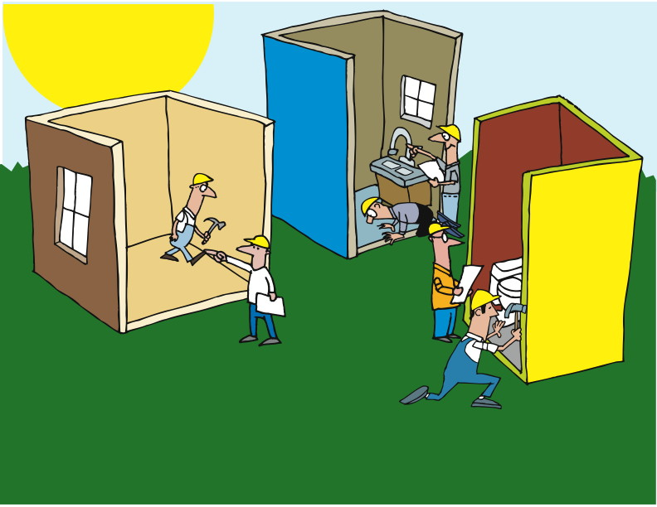
Notes:
And by using a combination of regression tests and deployment testing, we get away from the common developer assertion that “it works on MY box!”

Slide 18
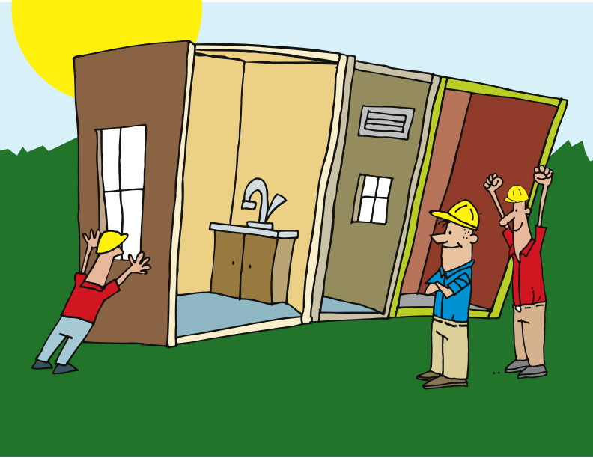
Notes:
Since we’re testing on a build server – or maybe on multiple servers – and testing the deployment as we go, we reduce the number of surprises we receive at the end.

